Slide 1
Are You an Accident of Nature?
Part 9
Humans are going extinct

Slide 2
Miscarriages
Roughly 15% of pregnancies
Genetic and chromosomal errors are the most common cause
Notes:
Roughly 10 to 25% of detected pregnancies end in miscarriages.
However, it is thought that many more fertilized eggs, end in miscarriages that happen too early for the woman to detect that she is pregnant.
From http://americanpregnancy.org/pregnancy-complications/miscarriage/
American Pregnancy Association
During the first trimester, the most common cause of miscarriage is chromosomal abnormality – meaning that something is not correct with the baby’s chromosomes. Most chromosomal abnormalities are the cause of a damaged egg or sperm cell, or are due to a problem at the time that the zygote went through the division process
From http://www.metaprimate.com/primate-species/chimpanzee-vs-human-genome.html
An estimated 70 to 80% of protein sequences differ between P. troglodytes and H. sapiens, although an average difference is only two aminoacid residues

Slide 3
Every child gets roughly 100 new mutations from its parents.

Slide 4

Each GenerationMutations Accumulate
Grand Child
Grand Child
Grand Child
Child
Child
Child
Parent
Parent
Parent
Parent

Slide 5
ENCODE
Large international consortium of
genome scientists
Essentially all human DNA is transcribed (used)
Most of it in both directions
Most nucleotides are not only functional,
but poly-functional (multiple roles)
Source: Book Genetic Entropy 4th Ed,
pg 45 by Dr. J. C. Sanford
Notes:
Transcription is the first step of gene expression, in which a particular segment of DNA is copied into RNA (mRNA) by the enzyme RNA polymerase. Both RNA and DNA are nucleic acids, which use base pairs of nucleotides as a complementary language. Source: https://en.wikipedia.org/wiki/Transcription_(genetics)
At least half of DNA “appears to be transcribed in both directions”(Yelin et al., 2003)
Most of both strands of DNA are functional.
------- below from pg 21 of 4th Ed of Genetic Entropy -----------
“ . . evidence suggests 80% or more is functional (The ENCODE Project Consortium, 2012)”
--------------------- NY Times
September 5, 2012
Bits of Mystery DNA, Far From ‘Junk,’ Play Crucial Role
By GINA KOLATA
¶Among the many mysteries of human biology is why complex diseases like diabetes, high blood pressure and psychiatric disorders are so difficult to predict and, often, to treat. An equally perplexing puzzle is why one individual gets a disease like cancer or depression, while an identical twin remains perfectly healthy.
¶Now scientists have discovered a vital clue to unraveling these riddles. The human genome is packed with at least four million gene switches that reside in bits of DNA that once were dismissed as “junk” but that turn out to play critical roles in controlling how cells, organs and other tissues behave. The discovery, considered a major medical and scientific breakthrough, has enormous implications for human health because many complex diseases appear to be caused by tiny changes in hundreds of gene switches.
¶The findings, which are the fruit of an immense federal project involving 440 scientists from 32 laboratories around the world, will have immediate applications for understanding how alterations in the non-gene parts of DNA contribute to human diseases, which may in turn lead to new drugs. They can also help explain how the environment can affect disease risk. In the case of identical twins, small changes in environmental exposure can slightly alter gene switches, with the result that one twin gets a disease and the other does not.
¶As scientists delved into the “junk” — parts of the DNA that are not actual genes containing instructions for proteins — they discovered a complex system that controls genes. At least 80 percent of this DNA is active and needed. The result of the work is an annotated road map of much of this DNA, noting what it is doing and how. It includes the system of switches that, acting like dimmer switches for lights, control which genes are used in a cell and when they are used, and determine, for instance, whether a cell becomes a liver cell or a neuron.
¶“It’s Google Maps,” said Eric Lander, president of the Broad Institute, a joint research endeavor of Harvard and the Massachusetts Institute of Technology. In contrast, the project’s predecessor, the Human Genome Project, which determined the entire sequence of human DNA, “was like getting a picture of Earth from space,” he said. “It doesn’t tell you where the roads are, it doesn’t tell you what traffic is like at what time of the day, it doesn’t tell you where the good restaurants are, or the hospitals or the cities or the rivers.”
¶The new result “is a stunning resource,” said Dr. Lander, who was not involved in the research that produced it but was a leader in the Human Genome Project. “My head explodes at the amount of data.”
¶The discoveries were published on Wednesday in six papers in the journal Nature and in 24 papers in Genome Research and Genome Biology. In addition, The Journal of Biological Chemistry is publishing six review articles, and Science is publishing yet another article.
¶Human DNA is “a lot more active than we expected, and there are a lot more things happening than we expected,” said Ewan Birney of the European Molecular Biology Laboratory-European Bioinformatics Institute, a lead researcher on the project.
¶In one of the Nature papers, researchers link the gene switches to a range of human diseases — multiple sclerosis, lupus, rheumatoid arthritis, Crohn’s disease, celiac disease — and even to traits like height. In large studies over the past decade, scientists found that minor changes in human DNA sequences increase the risk that a person will get those diseases. But those changes were in the junk, now often referred to as the dark matter — they were not changes in genes — and their significance was not clear. The new analysis reveals that a great many of those changes alter gene switches and are highly significant.
¶“Most of the changes that affect disease don’t lie in the genes themselves; they lie in the switches,” said Michael Snyder, a Stanford University researcher for the project, called Encode, for Encyclopedia of DNA Elements.
¶And that, said Dr. Bradley Bernstein, an Encode researcher at Massachusetts General Hospital, “is a really big deal.” He added, “I don’t think anyone predicted that would be the case.”
¶The discoveries also can reveal which genetic changes are important in cancer, and why. As they began determining the DNA sequences of cancer cells, researchers realized that most of the thousands of DNA changes in cancer cells were not in genes; they were in the dark matter. The challenge is to figure out which of those changes are driving the cancer’s growth.
¶“These papers are very significant,” said Dr. Mark A. Rubin, a prostate cancer genomics researcher at Weill Cornell Medical College. Dr. Rubin, who was not part of the Encode project, added, “They will definitely have an impact on our medical research on cancer.”
¶In prostate cancer, for example, his group found mutations in important genes that are not readily attacked by drugs. But Encode, by showing which regions of the dark matter control those genes, gives another way to attack them: target those controlling switches.
¶Dr. Rubin, who also used the Google Maps analogy, explained: “Now you can follow the roads and see the traffic circulation. That’s exactly the same way we will use these data in cancer research.” Encode provides a road map with traffic patterns for alternate ways to go after cancer genes, he said.
¶Dr. Bernstein said, “This is a resource, like the human genome, that will drive science forward.”
¶The system, though, is stunningly complex, with many redundancies. Just the idea of so many switches was almost incomprehensible, Dr. Bernstein said.
¶There also is a sort of DNA wiring system that is almost inconceivably intricate.
¶“It is like opening a wiring closet and seeing a hairball of wires,” said Mark Gerstein, an Encode researcher from Yale. “We tried to unravel this hairball and make it interpretable.”
¶There is another sort of hairball as well: the complex three-dimensional structure of DNA. Human DNA is such a long strand — about 10 feet of DNA stuffed into a microscopic nucleus of a cell — that it fits only because it is tightly wound and coiled around itself. When they looked at the three-dimensional structure — the hairball — Encode researchers discovered that small segments of dark-matter DNA are often quite close to genes they control. In the past, when they analyzed only the uncoiled length of DNA, those controlling regions appeared to be far from the genes they affect.
¶The project began in 2003, as researchers began to appreciate how little they knew about human DNA. In recent years, some began to find switches in the 99 percent of human DNA that is not genes, but they could not fully characterize or explain what a vast majority of it was doing.
¶The thought before the start of the project, said Thomas Gingeras, an Encode researcher from Cold Spring Harbor Laboratory, was that only 5 to 10 percent of the DNA in a human being was actually being used.
¶The big surprise was not only that almost all of the DNA is used but also that a large proportion of it is gene switches. Before Encode, said Dr. John Stamatoyannopoulos, a University of Washington scientist who was part of the project, “if you had said half of the genome and probably more has instructions for turning genes on and off, I don’t think people would have believed you.”
¶By the time the National Human Genome Research Institute, part of the National Institutes of Health, embarked on Encode, major advances in DNA sequencing and computational biology had made it conceivable to try to understand the dark matter of human DNA. Even so, the analysis was daunting — the researchers generated 15 trillion bytes of raw data. Analyzing the data required the equivalent of more than 300 years of computer time.
¶Just organizing the researchers and coordinating the work was a huge undertaking. Dr. Gerstein, one of the project’s leaders, has produced a diagram of the authors with their connections to one another. It looks nearly as complicated as the wiring diagram for the human DNA switches. Now that part of the work is done, and the hundreds of authors have written their papers.
¶“There is literally a flotilla of papers,” Dr. Gerstein said. But, he added, more work has yet to be done — there are still parts of the genome that have not been figured out.

Slide 6
 |  | L |  |  | B
 | R | E | T | R | E | A | T
 |  | G | O | O | D
 |  |  | P | A
 |  |  |  | D

Slide 7
ENCODE Implies
Little to no junk DNA
Almost all mutations bad

Slide 8
Nearly neutral mutations
Most nucleotide mutations are
“nearly neutral”
Harmful, but the effect is so small that natural selection cannot remove them
Therefore, they accumulate.
Like a car rusting one atom at a time.
Humans doomed to die out
Source: Book Genetic Entropy 4th Ed,
pg 19-28 by Dr. J. C. Sanford

Slide 9
Geneticists say DNA is declining
Consensus

Slide 10
Proc. Natl. Acad. Sci. USA Vol. 94, pp. 8380–8386, August 1997
The high spontaneous mutation rate: Is it a health risk?
We're inferior to stoneage man. (paraphrase)
Dr. James F. Crow

Slide 11
Dr. James F. Crow
Perhaps most distinguished geneticist of the 20th century
President American Society of Human Genetics
President Genetics Society of America
National Academy of Sciences

Slide 12
No geneticist doubts man degenerating
Dr. Alexey S. Kondroshov

Slide 13
Dr. Kondroshov
Highly distinguished geneticist
Univ of Michigan
Sources:
1) Told John Sanford this.
2) See his paper "Deleterious mutations and the evolution of sexual reproduction" Nature 336, 435 - 440.

Slide 14
We're degenerating at 1-5% per generation.
Dr. Michael Lynch

Slide 15
Dr. Michael Lynch
Evolutionary geneticist
National Academy of Sciences
Proceeding of the National Academy of Science PNAS 107:961-968
Notes:
Dr. Lynch is an evolutionary geneticist who was elected to the National Academy of Sciences in 2009.
Distinguished professor of biology at Indiana University.
See his paper: Proceeding of the National Academy of Science PNAS 107:961-968 (1-5% is based on assuming a low mutation rate (less than 100 mutations per generation.)

Slide 16
Foregoing slides adapted from DVD
The Mystery of our Declining Genes
by Dr. John C. Sanford

Slide 17
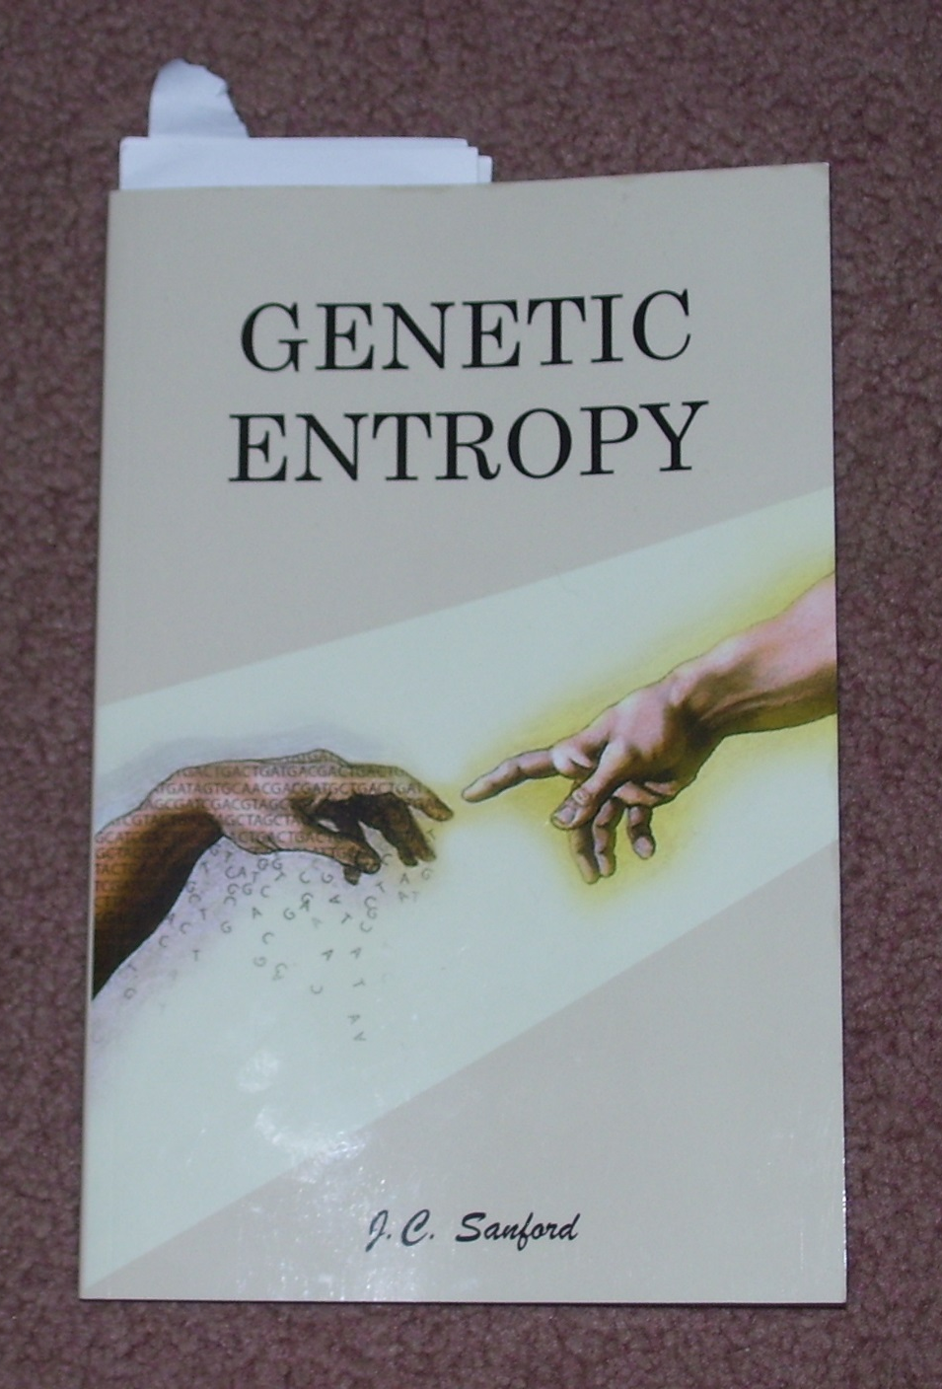
By Dr. J. C. Sanford
FMS Publications
Notes:
Dr John C. Stanford was an Associate Professor at Cornell and has published over 70 professional papers and has dozens of patents. An inventor of the “gene gun”, which is widely used in creating better agricultural crops.

Slide 18
Can small changes add up?
Sequenced DNA of both
Chimps and Humans
Notes:
From https://answersingenesis.org/genetics/dna-similarities/what-about-the-similarity-between-human-and-chimp-dna/
In the fall of 2005, in a special issue of Nature devoted to chimpanzees, researchers reported the draft sequence of the chimpanzee genome.2 At the time, some researchers called it “the most dramatic confirmation yet”3 of Darwin’s theory that man shared a common ancestor with the apes. One headline read: “Charles Darwin Was Right and Chimp Gene Map Proves It.”4
So what is this great and overwhelming “proof” of chimp-human common ancestry? Researchers found 96 percent genetic similarity and a difference between us of 4 percent. Further, the use of percentages obscures the magnitude of the differences. For example, 1.23 percent of the differences are single base pair substitutions (figure 5).6 This doesn’t sound like much until you realize that it represents about 35 million differences! But that is only the beginning. There are 40–45 million bases present in humans that are missing from chimps and about the same number present in chimps that are absent from man. These extra DNA nucleotides are called “insertions” or “deletions” because they are thought to have been added to or lost from the original sequence. (Substitutions and insertions are compared in figure 5.) This puts the total number of DNA differences at about 125 million. However, since the insertions can be more than one nucleotide long, there are about 40 million total separate mutation events that would separate the two species in the evolutionary view.
for the sake of analyzing the argument, then 40 million separate mutation events would have had to take place and become fixed in the population in only 300,000 generations. This is an average of 133 mutations locked into the genome every generation. Locking in such a staggering number of mutations in a relatively small number of generations is a problem referred to as “Haldane’s dilemma.”7

Slide 19
Chimps become Humans?
Evolutionists estimate 40,000,000 mutation events comprising 125,000,000 DNA nucleotide differences
To be true it would require 100 mutations per generation to get “locked into” a genome
Not remotely possible
Notes:
From https://en.wikipedia.org/wiki/Chimpanzee_genome_project
Analysis of the genome was published in Nature on September 1, 2005, in an article produced by the Chimpanzee Sequencing and Analysis Consortium, a group of scientists which is supported in part by the National Human Genome Research Institute, one of the National Institutes of Health. The article marked the completion of the draft genome sequence.^{[4]} A database ^{[5]} now exists containing the genetic differences between human and chimpanzee genes, with about thirty-five million single-nucleotide changes, five million insertion/deletion events, and various chromosomal rearrangements. Gene duplications account for most of the sequence differences between humans and chimps. Single-base-pair substitutions account for about half as much genetic change as does gene duplication.
100 mutations per gener based on 1st humans were 6,000,000 years ago, avg age of 15 years when children born; 40,000,000 mutation required.
Typical human and chimp homologs of proteins differ in only an average of two amino acids. About 30 percent of all human proteins (where homologs exist) are identical in sequence to the corresponding chimp protein. [Mike’s note: another article says that 20% (of the homologs) are identical. There are proteins in humans that have no homologs in chimps and vice versa.] As mentioned above, gene duplications are thought to be a major source of differences between human and chimp genetic material, with about 2.7 percent of the genome now representing differences having been produced by gene duplications or deletions during approximately 6 million years ^{[6]} since humans and chimps diverged from their common evolutionary ancestor. The comparable variation within human populations is 0.5 percent.^{[7]}

Slide 20
Conclusion
Modern genetics has discovered that the DNA of humans is declining.
We will eventually go extinct,
if God does not intervene.
The rate of mutations and miscarriages supports that humans must have been created fairly recently.

Slide 21
Give your own presentations.
Free downloads of PowerPoints used in these videos at:
Educate7.com

Slide 22
Next video:
Are You an Accident of Nature?
Part 10
Fossils

